Slide 1
Encryption: Keeping Secrets a Secret
UAH Tech Trek Outreach Teacher’s Camp
June 2018

Slide 2
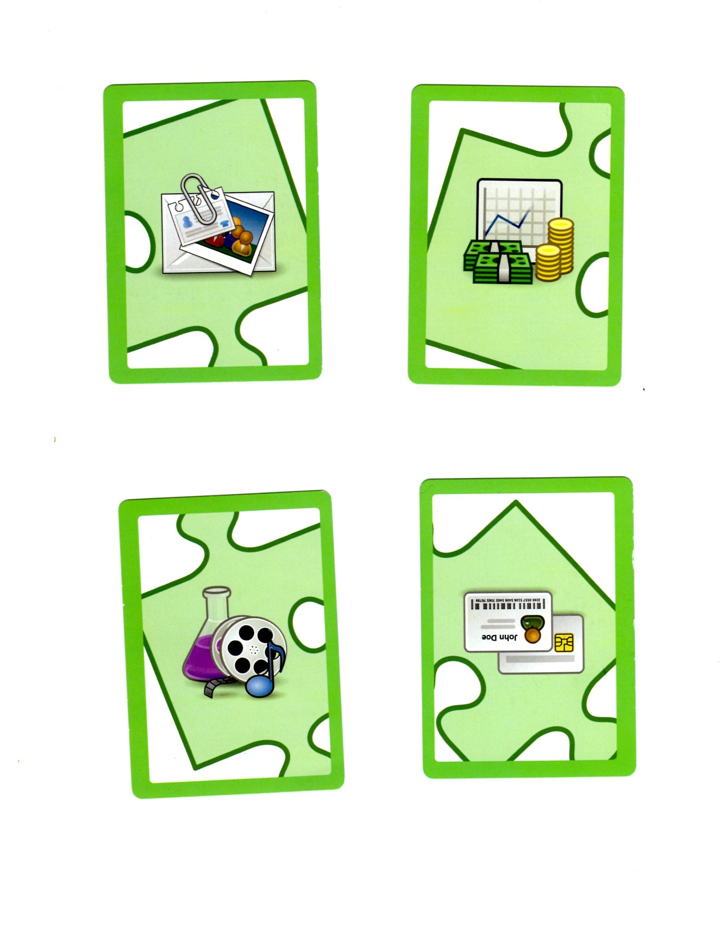
What are things you want to keep secret?
Financial
Information
Personally Identifiable Information
Intellectual Property
Logins/Passwords

Slide 3
Facts about Cybercrimes
73% of Americans have been victims of cybercrimes through data breaches and viruses
90% of US companies said their computers were breached at least once in the past 12 months
Cybercrimes damage costs are expected to reach $6 trillion annually in 5 years
Cybersecurity spending will exceed $1 trillion annually in 5 years
Globally, there will be 6 million cybersecurity job openings by 2019.

Slide 4



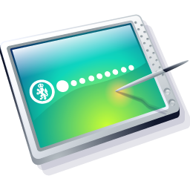
Supergirl
Spidergirl
Notes:
Two superhero – Supergirl and Spidergirl need to send messages to each other using the internet.

Slide 5

I will steal their secret!
I know their secret!!
Hacker
Supergirl
Spidergirl
Notes:
When Supergirl sends a message, a hacker is listening and will read the message before it gets to Spidergirl. Now the hacker knows their secret messages.

Slide 6
Let’s use encryption!
We need a way to key our secret messages a secret!
Supergirl
Spidergirl
Notes:
Supergirl and Spidergirl need to keep their secret messages a secret. How? Encryption!!

Slide 7
Only you and I will understand it!
Right! We will turn our message into a code!
Supergirl
Spidergirl

Slide 8
I will encrypt the message before I send it to you.
Original message
Encryption Process
Encrypted message
Supergirl
Spidergirl

Slide 9
I will decrypt the message so I can read it.
Encrypted message
Decryption Process
Spidergirl
Original message
Supergirl

Slide 10
Wait! I can’t read this.
Foiled Again!
Hacker
Supergirl
Spidergirl
Notes:
Supergirl wants to send a message

Slide 11
What is Encryption?
A message in its original form (plaintext) is encrypted into an unintelligible form called a ciphertext by a set of procedures known as encryption
Encryption requires a cipher and a key

Slide 12
Cipher and Key
The cipher is a set of rules you are using to encode the message
The key tells you how to arrange those rules

Slide 13
Caesar Cipher
Julius Caesar (100 BC) used encryption to keep his messages safe.
  Cipher: shifting the letters of the alphabet by a certain number.
  Key: number of letters shifted for a particular message.

Slide 14
Caesar Cipher
Cipher: Shift the alphabet Key: 4
Plaintext letters
ABCDEFGHIJKLMNOPQRSTUVWXYZ
WXYZ
WXYZABCDEFGHIJKLMNOPQRSTUV
Ciphertext letters
GIRLS ROCK
CENHO NKYG

Slide 15
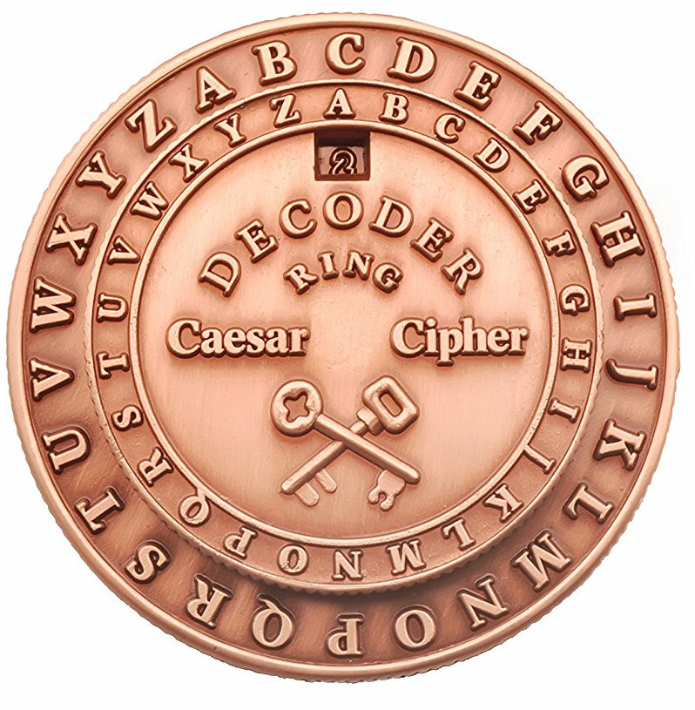
MAKE YOUR OWN
CAESAR CIPHER

Slide 16
Cut out the circles

Slide 17
Write the alphabet on the circles
Color One
Color Two
A B C D E F G H I J K L M N O P Q R S T U V W X Y
Z
Z
A B C D E F G H I J K L M N O P Q R S T U V W X Y

Slide 18
Align the circles at the center dots.
Turn the inner wheel.
A B C D E F G H I J K L M N O P Q R S T U V W X Y
Z
Z
A B C D E F G H I J K L M N O P Q R S T U V W X Y

Slide 19
Encrypt!!
Cipher: Rotate the alphabet clockwise
Key: 7
APPLE becomes TIIEX
A B C D E F G H I J K L M N O P Q R S T U V W X Y
Z
Z
A B C D E F G H I J K L M N O P Q R S T U V W X Y

Slide 20
Send a secret message
Pair up with your neighbor.
Decide on a key – the shift in the alphabet and whether the shift in clockwise or counter clockwise
Encode a short message and give it your to partner.
Can they decode it correctly?

Slide 21
Hackers!
The Caesar cipher is actually pretty easy to break.
Let’s try:
Ciphertext: CWWH QGMJ KWUJWL

Slide 22
How long did it take?
A person might take a few minutes to a few hours depending on the length of the message
A computer would take a fraction of a second!!!!
We need a better and stronger method

