Slide 1

RASPBERRY PI
Session 1
Cyber-Charged Summer Camp
Dr. English

Slide 2

What is a Raspberry Pi?
A credit-card-sized computer that plugs into your TV and a keyboard.
A capable little computer which can be used in electronics projects, and for many of the things that your desktop PC does, like spreadsheets, word processing, browsing the internet, writing programs, playing games, and playing high-definition video.
A capable computer designed by a group of British scientists to be affordable and accessible.
A computer that belongs to YOU!!

Slide 3
What is a Raspberry Pi?
Go to videos: https://www.raspberrypi.org/help/videos/

Slide 4
Why is it called Raspberry Pi?
Using fruit is a somewhat historical naming convention
Tangerine Computer Systems
Apricots Computers
Apple Computers
Blackberry
Pi is for Python – the primary programming language used

Slide 5
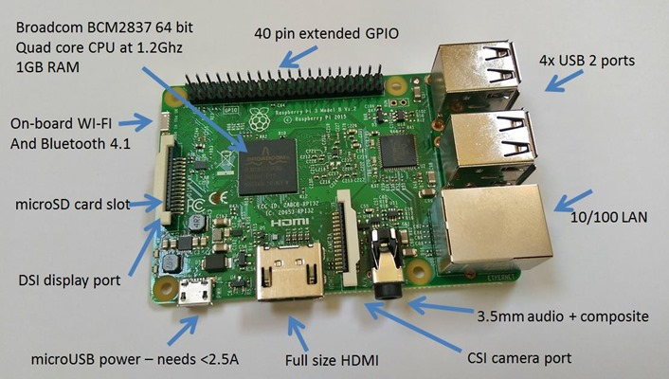
Parts of the Pi

Slide 6
CPU: carries out the instructions of a computer program by performing the basic arithmetic, logical, control and input/output (I/O) operations specified by the instructions
What does 1.2 Ghz mean?
What does 1 GB RAM mean?
What does quad core mean?
WI-FI/Bluetooth: to access the internet or connect devices.
What is the difference between WI-FI and Bluetooth?

Slide 7
microSD card slot: holds your Pi’s OS and other programs.
Where might you have seen something like this before?
That’s about the same as what your cell phone battery
Power: uses a microUSB connector 5V and ~ 2A

Slide 8
USB ports: connect a USB keyboard, mouse, and other peripherals
What does USB stand for?
HDMI: use a TV or monitor to see what your Pi is doing
What does HDMI stand for?
Notes:
HDMI: High Definition Media Interface USB: Universal Serial Bus

Slide 9
LAN: Ethernet connection for a Local Area Network
Does your school use WI-FI or a LAN?
3.5 mm audio: use standard headphones or even speakers
Notes:
HDMI: High Definition Media Interface USB: Universal Serial Bus

Slide 10
GPIO: General Purpose Input/Output – important for hardware projects
Add a camera to your projects
Notes:
HDMI: High Definition Media Interface USB: Universal Serial Bus

Slide 11
Let’s Put your Pi Together
Plug in power last!
Most connections are one way only so it’s hard to mess it up!
Be careful with your microSD card – gently slide it into the slot
Stick on the heat sinks on the CPU chip and the LAN chip. What are heat sinks? Why are they shaped the way they are?
Don’t forget to read the instructions when you get home.
Ready for power – great! Let’s take a look around

