Slide 1
Dealing with waste
Part I - Landfills

Slide 2
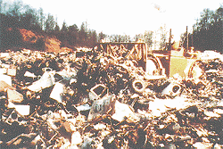
There are 3,091 active sanitary landfills in the U.S. and over 10,000 old municipal landfills (rubbish pits).

Slide 3
Vocabulary
Leachate: the liquid that seeps from the MSW in a landfill, which may be toxic.
Vector: any animal or pest attracted to the garbage in landfills. They may spread disease.
Groundwater: the water that is under the ground. This water is commonly used as a drinking water source. It can be contaminated by leachate.

Slide 4
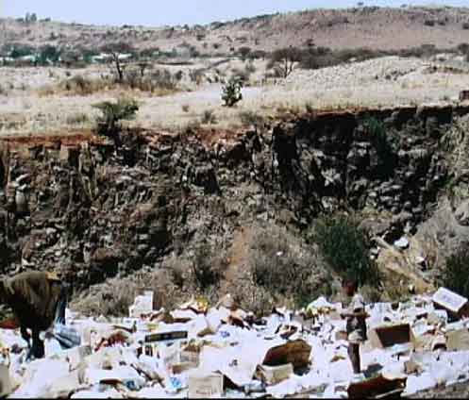
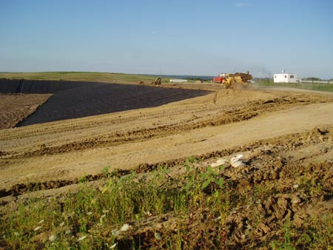
Rubbish Pit vs. Sanitary Landfill
Rubbish pits contain no liners.
Sanitary landfills include groundwater protection.

Slide 5
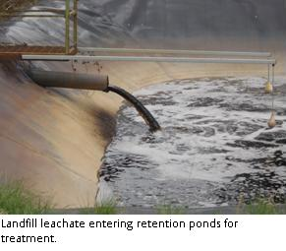
How is a Sanitary Landfill made?
Cavities are dug out of the ground
Walls are sealed with layers of clay and coated with plastic to prevent groundwater contamination from wastewater that accumulates.
Sanitary Landfills are designed to stay dry inside, except for liquids that ooze from some garbage, and rainwater that trickles through. As water trickles through a landfill, it dissolves chemicals and other particles, creating a liquid called "leachate."

Slide 6
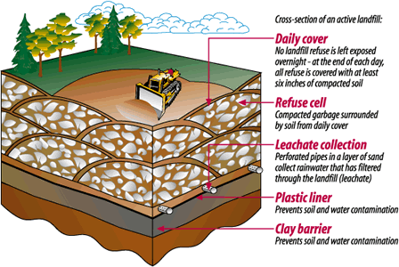
Cross-Section of a Landfill

Slide 7
What is done with the Leachate?
The contained leachate is run through pipes to above-ground storage tanks and hauled for treatment and disposal at a large regional wastewater treatment plant.
Does the leachate ever affect the groundwater?
Ideally, it shouldn’t, but no landfill is perfect.
The groundwater can be contaminated with the leachate.

Slide 8
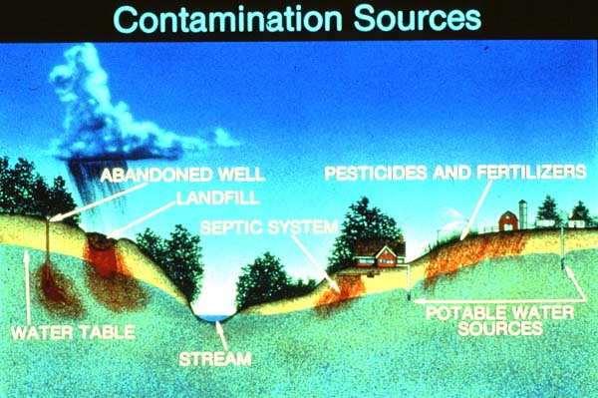
Leachate Problems

Slide 9
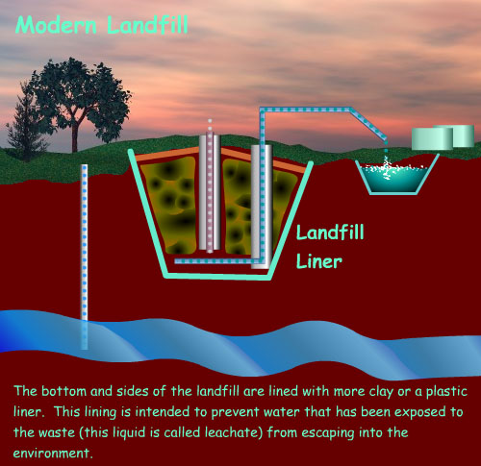

Slide 10
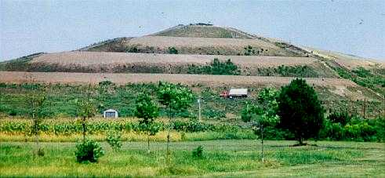
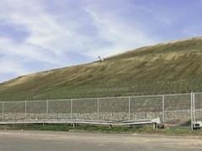
The Capping of a FULL Landfill

Slide 11
Garbage in landfills degrade, right?
Not really.
Landfills are mostly anaerobic. Without the oxygen and water needed to break down organic materials, all garbage decays very slowly in a landfill.
This means our garbage will probably be around for a very long time.

Slide 12
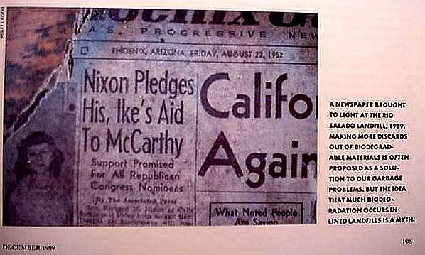
40 Yr-old Newspaper found in Landfill

Slide 13
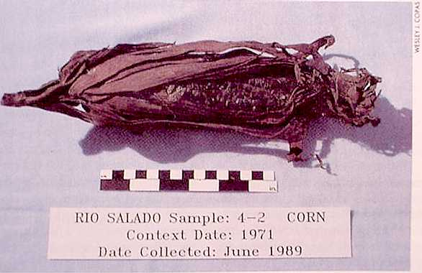
Even food does NOT degrade

Slide 14







Amount of Trash Thrown in Landfills (by weight)

Slide 15
Plastics
Plastics can take between 200-400 years to degrade. Only 3% of it is currently recycled.
Yard Waste
“Green Waste” (leaves, twigs, Christmas trees) can be shredded and used as mulch or composted.
Paper & Cardboard
Nationwide, paper & cardboard account for 41 % of all municipal solid waste. Only about 34.5 % is recycled in the U.S.

Slide 16
Metal
Recycling aluminum reduces both air and water pollution by more than 95% due to less energy needed to mine & process it. Only 38% of cans are recycled.
Glass
Glass was one of the first to be recycled and continues to lead all others in % recycled. It is the easiest recycled material to use and is the most cost efficient.
Food Waste
15.8 million tons of food goes to waste in the U.S. every year. Vegetable & plant matter can be composted (NOT meat or fats) and used for mulch.

