Slide 1

This is Engineering

Slide 2
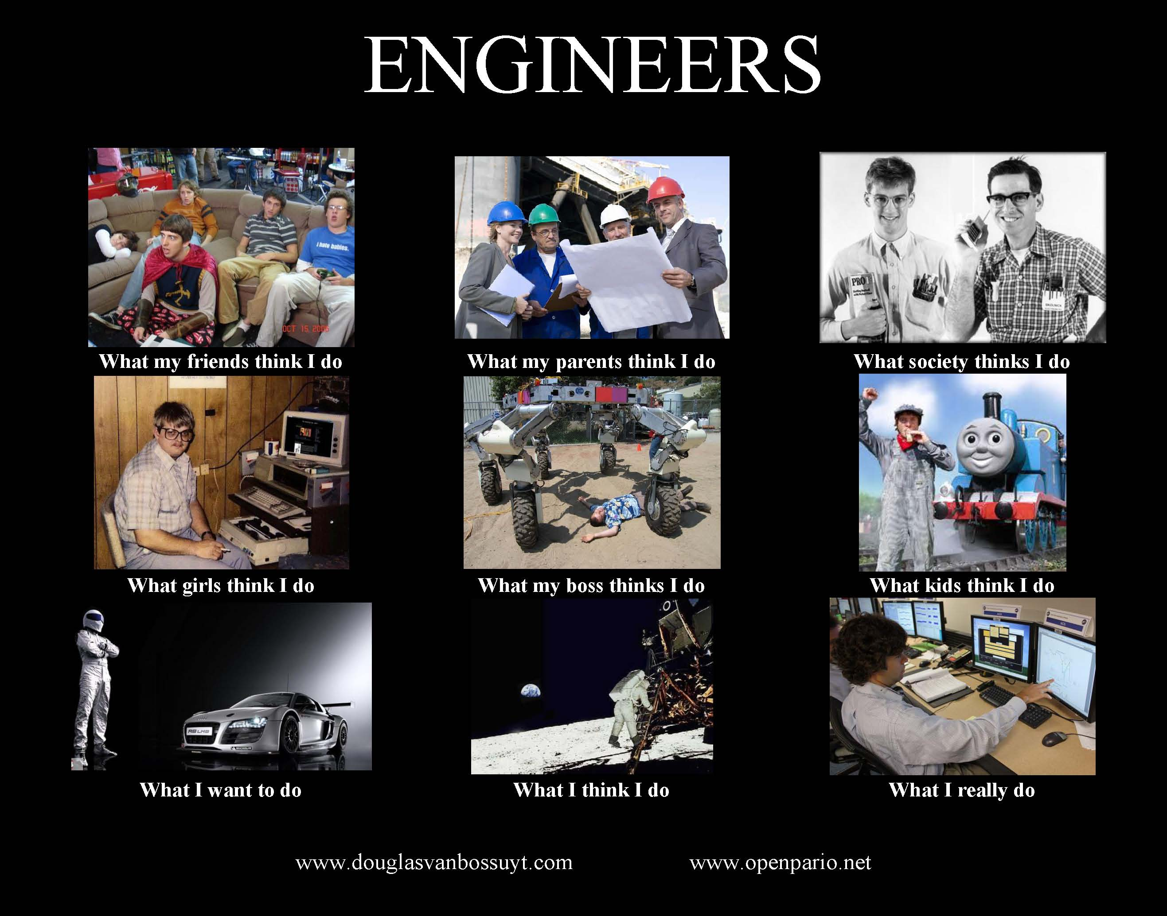

Slide 3

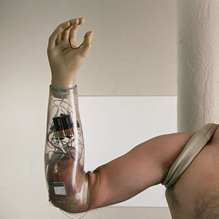



What do Engineers Do? – Solve Problems.
Understand the problem
Creative, innovative and practical solutions
Responsibility
Use math and science – also social science, business, arts.

Slide 4

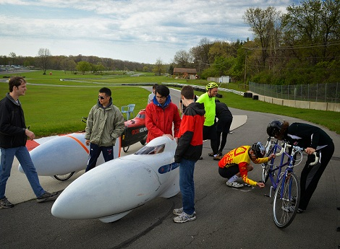
Engineers aren’t defined by their major.
Aerospace Engineers
Design, build, and test aircraft and spacecraft.
Materials, propulsion, and combustion
Aerodynamic design for bicycles

Slide 5

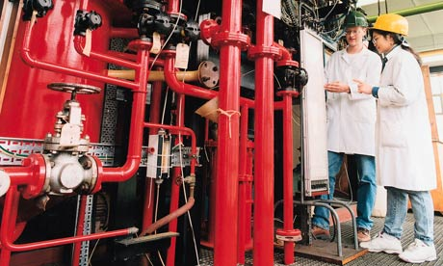
Engineers aren’t defined by their major.
Chemical Engineers
Develop and design chemical systems, materials, and fuels.
Develop materials to embed sensors into PJs to prevent SIDS

Slide 6
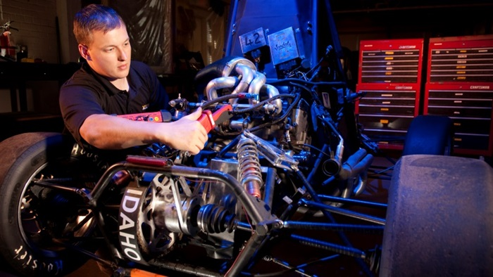

Engineers aren’t defined by their major.
Mechanical Engineers
Design and build machines, generators, and engines of all kinds.
Develop models to predict forest fire behavior.

Slide 7
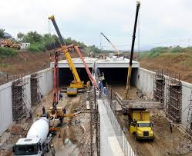
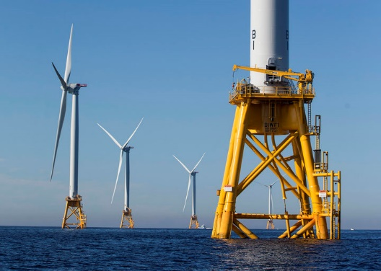
Engineers aren’t defined by their major.
Civil Engineers
Civil engineers build infrastructure projects including roads, bridges, and sewage treatment.
Affect daily human life by providing energy, water, and transportation.

Slide 8

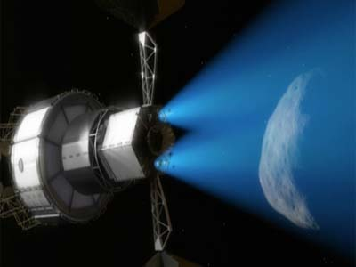
Engineers aren’t defined by their major.
Electrical Engineers
An electrical engineer is someone who designs and develops new electrical equipment.
Space projects - deep space communications, power generation and storage networks.

Slide 9


Engineers aren’t defined by their major.
Industrial and Systems Engineers
Industrial and systems engineering deals with the optimization of complex processes, systems, or organizations.
Work as automotive engineers to build safer and smart cars.

Slide 10


Engineers aren’t defined by their major.
Biological Engineers
Biological Engineering designs and analyses systems and structures in biological processes.
Work with doctors, therapists and researchers to solve patients’ problems.

Slide 11
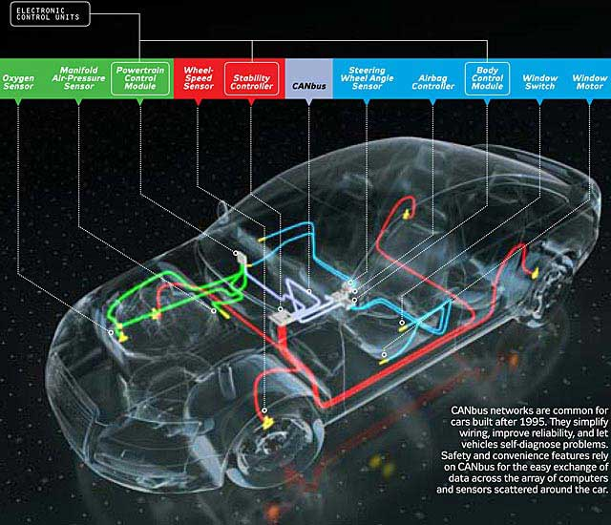
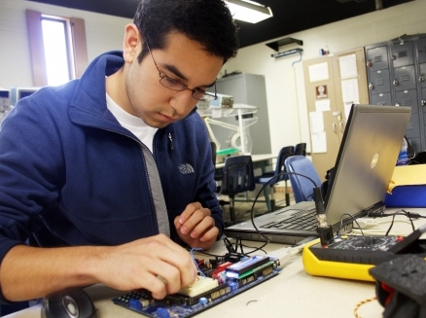
Engineers aren’t defined by their major.
Computer Engineers
Design computer software and hardware.
Work as automotive engineers to build safer and smart cars.

Slide 12
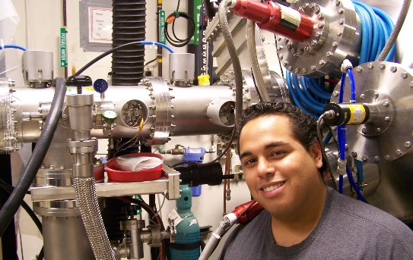

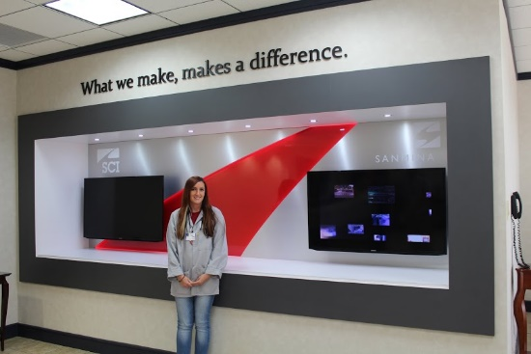
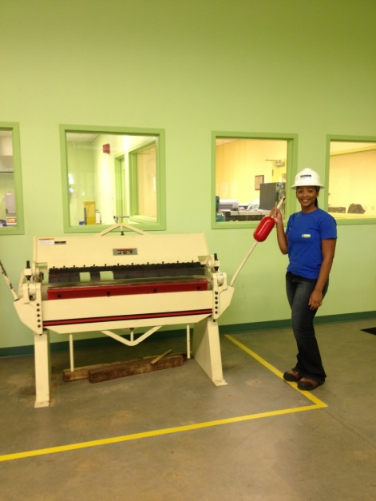
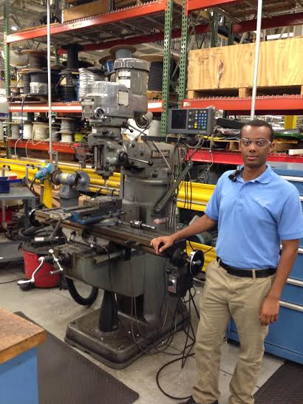
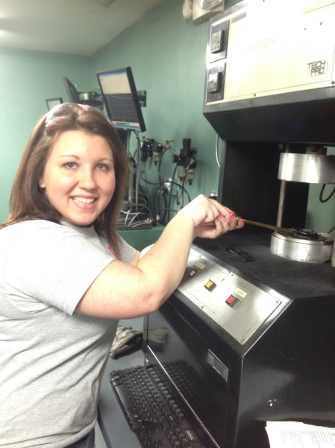
Joseph Burriss
Industrial & Systems Engineering
Employer: Mentor Graphics
Roberto Dextre
Aerospace Engineering
Employer: NASA
Ashley Keister
Electrical Engineering
Employer: Sanmina-SCI
Stacia Watts
Civil Engineering
Employer: ThyssenKrupp
Jonathan Mitike
Mechanical Engineering
Employer: Mercedes-Benz
Kristy Key
Chemical Engineering
Hexpol Compounding

Slide 13
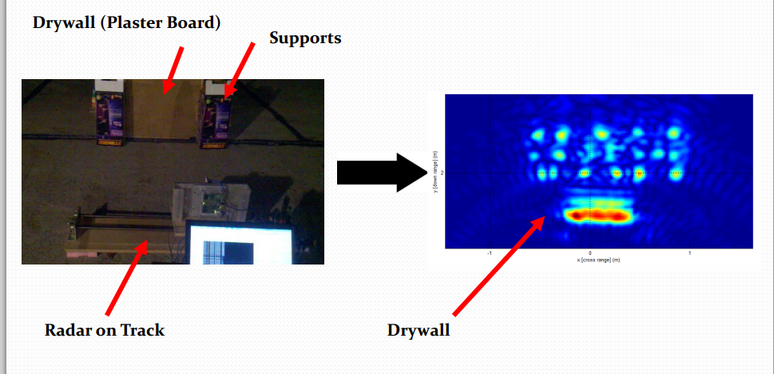
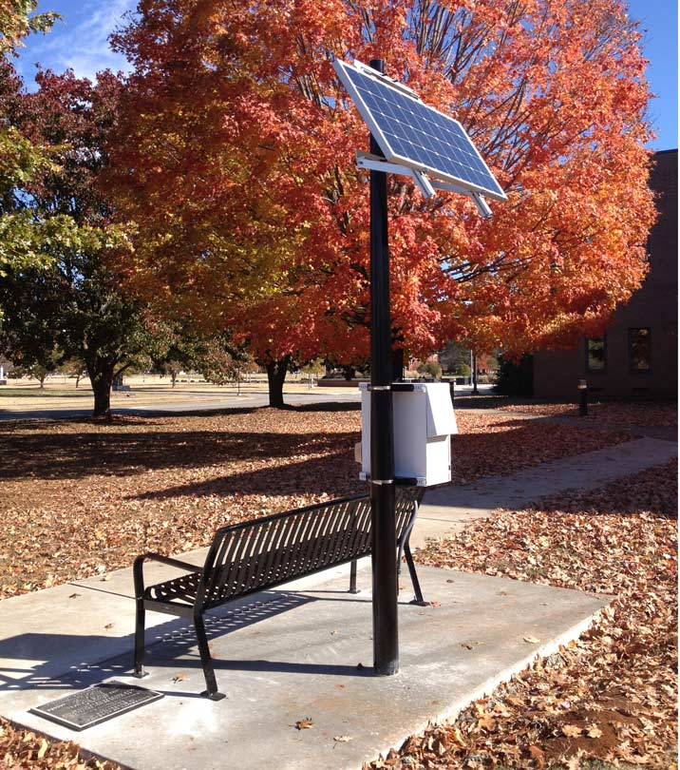
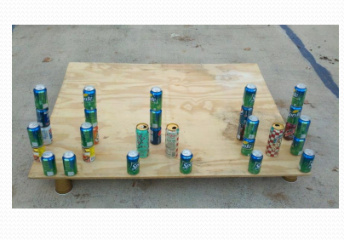
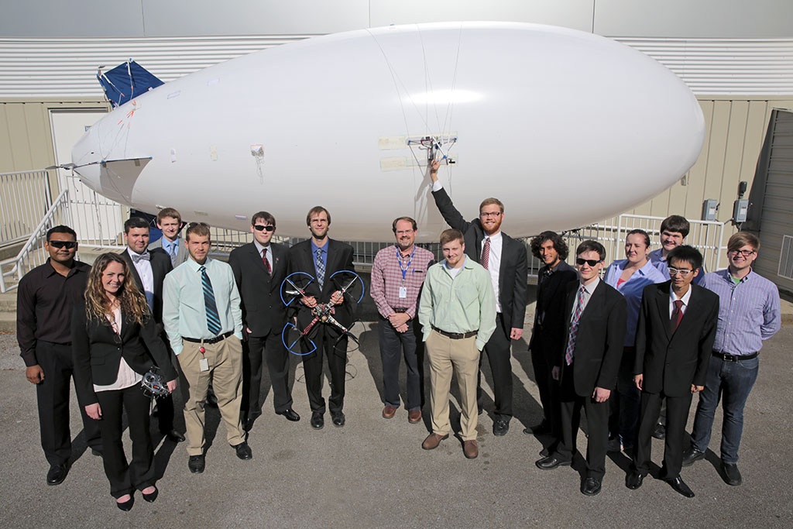
Student Design Experiences
Solar Powered Charging Station
UWB SAR
Aircraft Docking

Slide 14
Why Engineering?
Engineers are in demand
  Starting salary range: $51,000 to $67,000
  Mean annual salary range: $87,000 to $115,000
  Average growth in engineering jobs is over 10%
Engineers are in demand in Huntsville
  #1 concentration of electrical & aerospace engineering jobs
  #5 concentration of computer engineer jobs
Engineers work everywhere
  Design firms, building sites, plants, field work, law offices, hospitals
  Want to travel? Engineering may be the field for you
Engineers change the world
  Check out engineering grand challenges

Slide 15
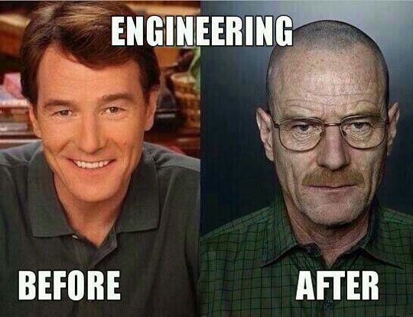
Myths about Engineering
Engineering is hard.

Slide 16
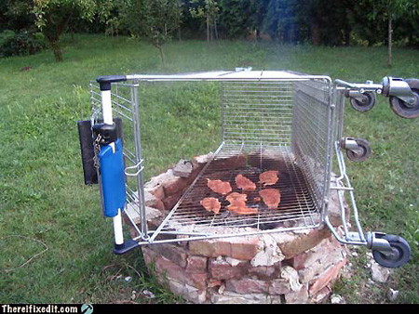
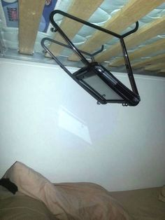
Myths about Engineering
Engineers are not creative.

Slide 17



Myths about Engineering
Engineers fall somewhere between Leonard and Sheldon on the social scale.

Slide 18

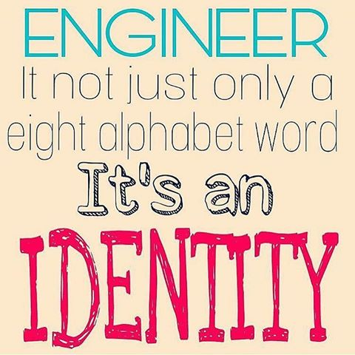
What makes a good engineering student?
Like math and science
Like solving problems
Like designing and building things
Like figuring out how things work
Like being challenged
Like working with diverse group of people

Slide 19
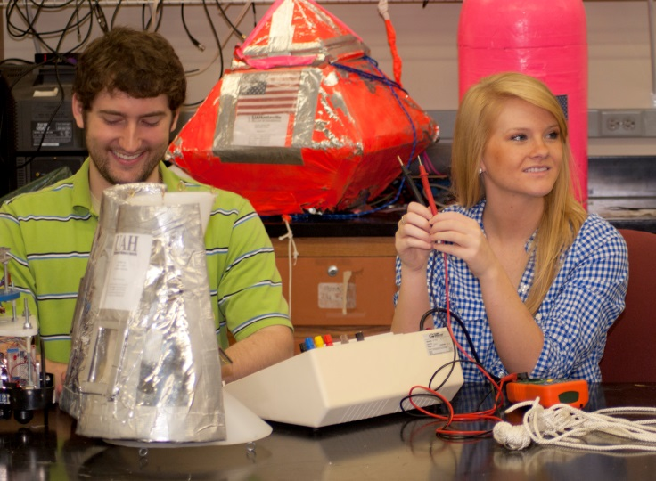


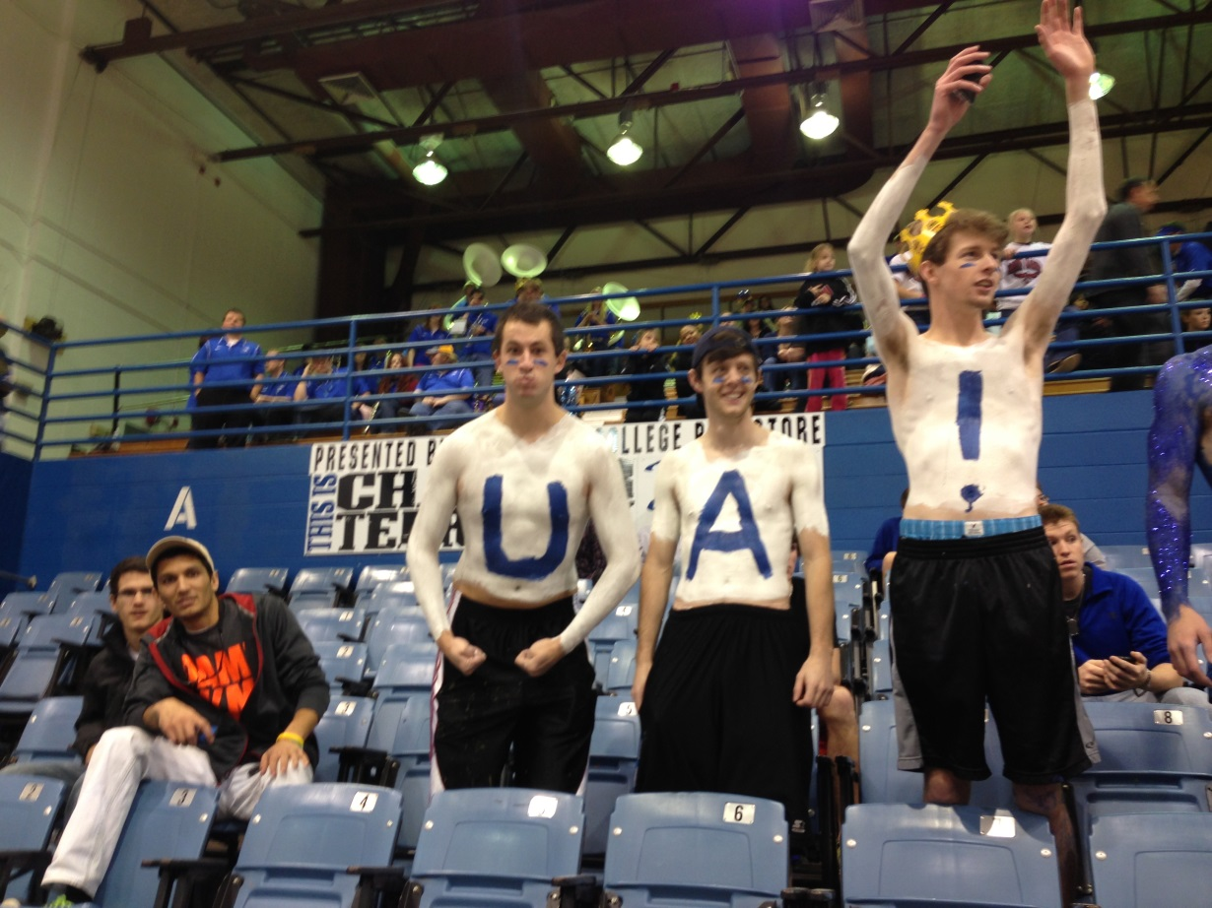
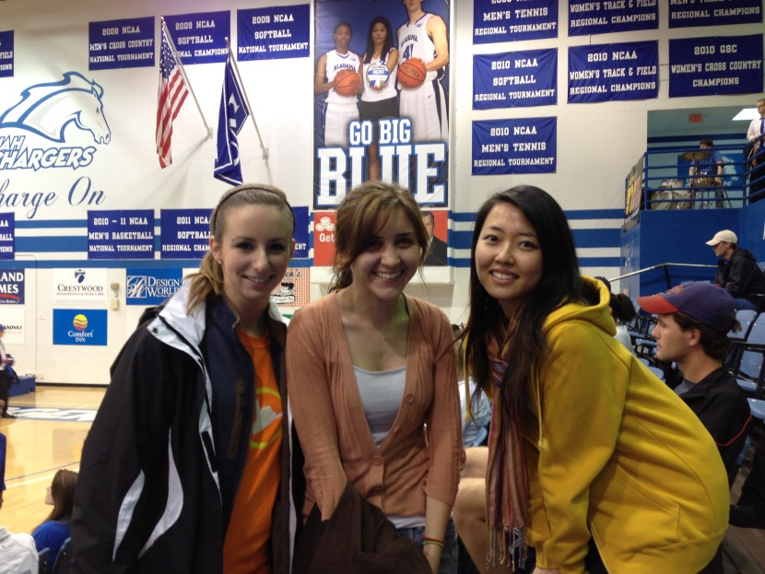
That test was tough!
You said it!

