Slide 1

Cyber Security For Civil Engineering
Lecture 2
Thiago Alves
Ph.D. Student at the University of Alabama in Huntsville

Slide 2
C-I-A Triad
Confidentiality
Integrity
Availability

Slide 3
attacks on SCADA systems

Slide 4
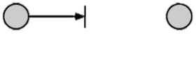
Interruption
An asset of the system is destroyed or becomes unavailable
Attack on availability
Destruction of hardware
Cutting of a communication line
May not be physical destruction
May be temporary

Slide 5
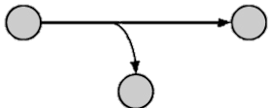
Interception
An unauthorized party gains access to an asset
Attack on confidentiality
Wiretapping to capture data in a network
Intercept a password -> bad
Intercept control data -> is it bad?

Slide 6
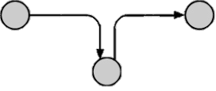
Modification
An unauthorized party gains access to an asset and tampers the data
Attack on integrity
Change values in a data file
Alter a program to make it perform differently
Modify content of messages transmitted on a network

Slide 7
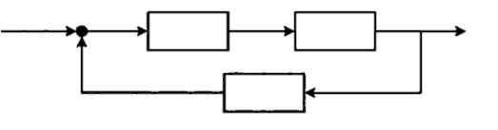
Modification
Modification on SCADA -> very bad!
Feedback control loop issues
Modifying measured output, measured error, system input, or reference affects system output
Reference
+
-
Measured
error
System
input
System output
Controller
System
Measured output
Sensor

Slide 8
Injection
An unauthorized party inserts counterfeit objects into the system
Attack on authenticity
Insertion of spurious messages in a network
Addition of records to a file
Injection on SCADA -> very bad!

Slide 9
Examples of attacks in real life

Slide 10
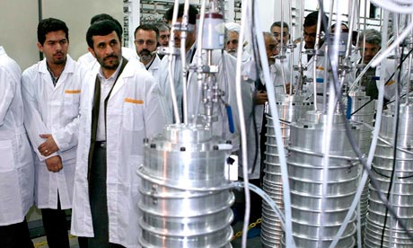
Stuxnet
Cyber attack specifically targeting Iranian centrifuges used for uranium enrichment
National state level attack
Penetrated isolated network
Destroyed 1/5th of the centrifuges in a secret Iranian facility

Slide 11
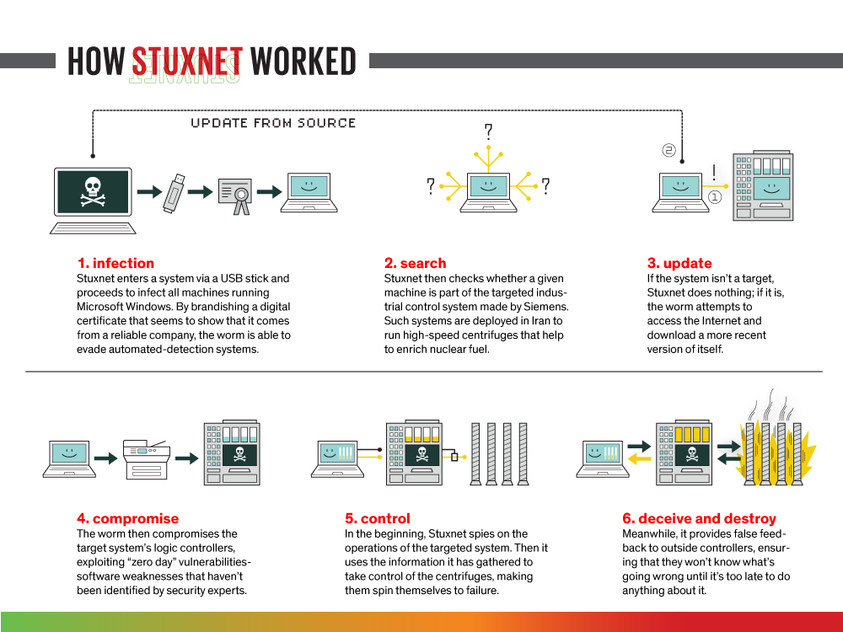

Slide 12
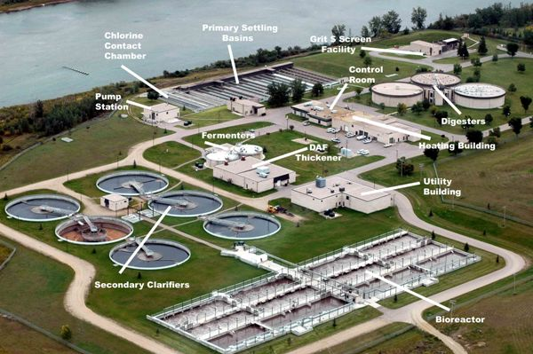
Maroochy Attack
Insider issued radio commands to Maroochy sewage equipment
Caused 800,000 liters of raw sewage to spill into local waterways
Marine life died, the creek water turned black and the stench was unbearable for residents
Insider used stolen laptop and radios

Slide 13
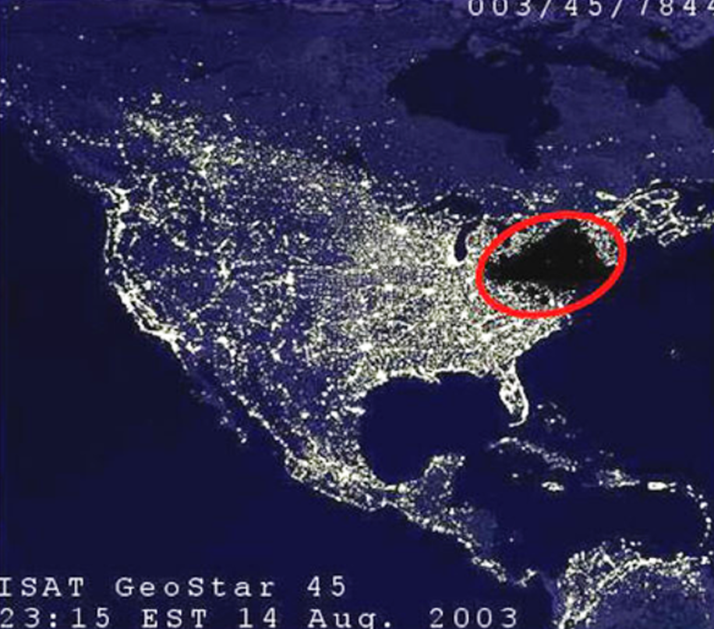
Ukrainian Power Grid Attack
Attacked 3 Ukrainian regional electricity distributors within 30 minutes of each other
225,000 customers lost power
Utilities forced to move to manual operation
Black Energy 3 malware: exploited remote desktop to damage the system. Erased Master Boot Record and some logs

Slide 14
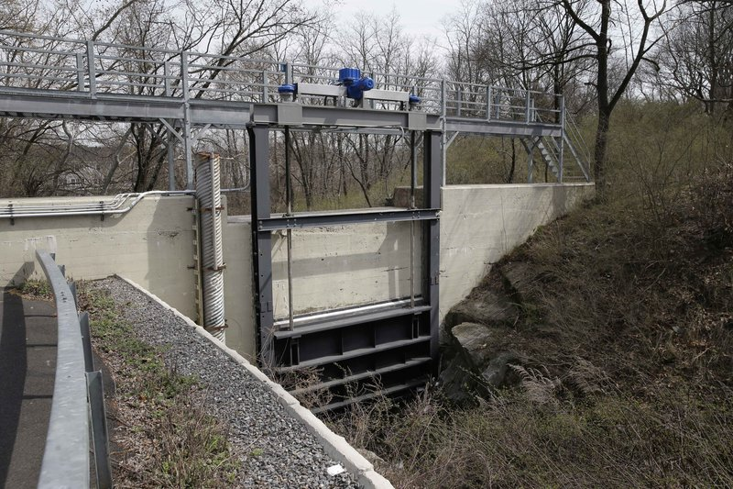
New York Dam Attack
Remotely accessed controls of the dam gates from Iran
Gate controls happened to be disconnected for maintenance, therefore it has not caused any serious injury
Attack not detected by dam operators

Slide 15
Vulnerability, Threat and Countermeasures
Vulnerability: weakness in a system that may be exploited
Threat: set of circumstances which has potential to cause harm
Countermeasure: Means to counter threats

Slide 16
A threat is blocked by applying countermeasures of a vulnerability

Slide 17
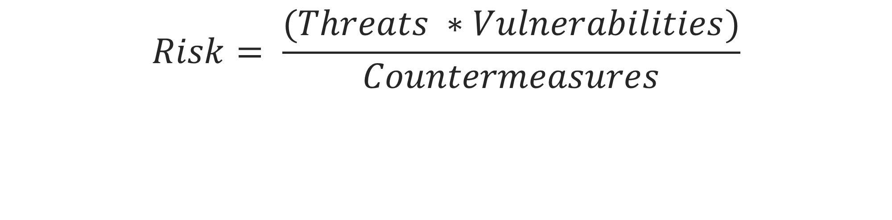
Risk Assessment
$$Risk= \frac{(Threats ∗Vulnerabilities)}{Countermeasures}$$
Notes:
If you have no threats, there is no risk
If you have no vulnerabilities, there is no risk
If you have no countermeasures, the risk is MAXIMUM

Slide 18
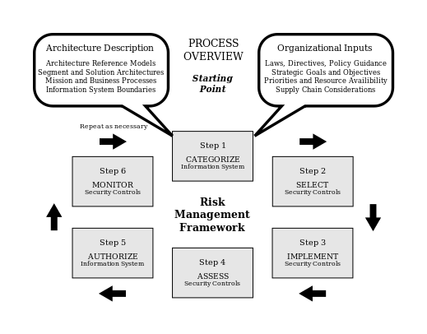
Risk Assessment
Notes:
If you have no threats, there is no risk
If you have no vulnerabilities, there is no risk
If you have no countermeasures, the risk is MAXIMUM

Slide 19
Risk Assessment
Categorize the system based on an impact analysis
Select an initial set of baseline security controls for the system based on the categorization done earlier
Implement the security controls
Assess the security controls to determine the extent to which they are implemented correctly
Authorize the system operation based on a determination of the risk and the decision that this risk is acceptable
Monitor the security controls in the system on an ongoing basis

Slide 20
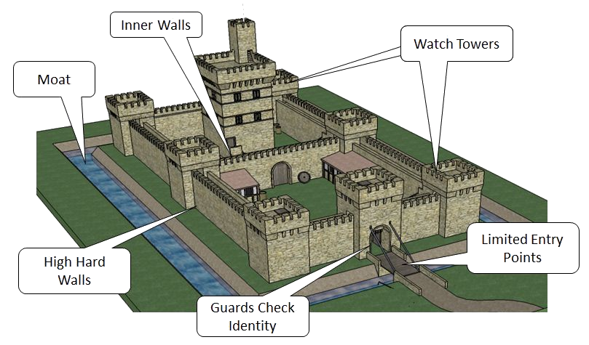
Defense in Depth

Slide 21
Defense in Depth
Defense in Depth (also known as Castle Approach) is a concept in which multiple layers of security controls are placed throughout a system
A countermeasure can, and will be defeated. Defense in depth provides additional layers of protection

Slide 22
Defense in Depth
Castle | Stored Secret
Moat | Computational infeasible barrier (encryption)
Outer Walls | Firewall, access control list
Watch tower | Monitoring, intrusion detection systems
Guard check | Access control (login with passwords)
Draw bridge | Close unused ports

Slide 23
Fail Safe / Fail Secure
Fail Safe: In the event of a failure, system responds in a way that will cause no harm
Fail Secure: Access or data will not be compromised due to failure

Slide 24
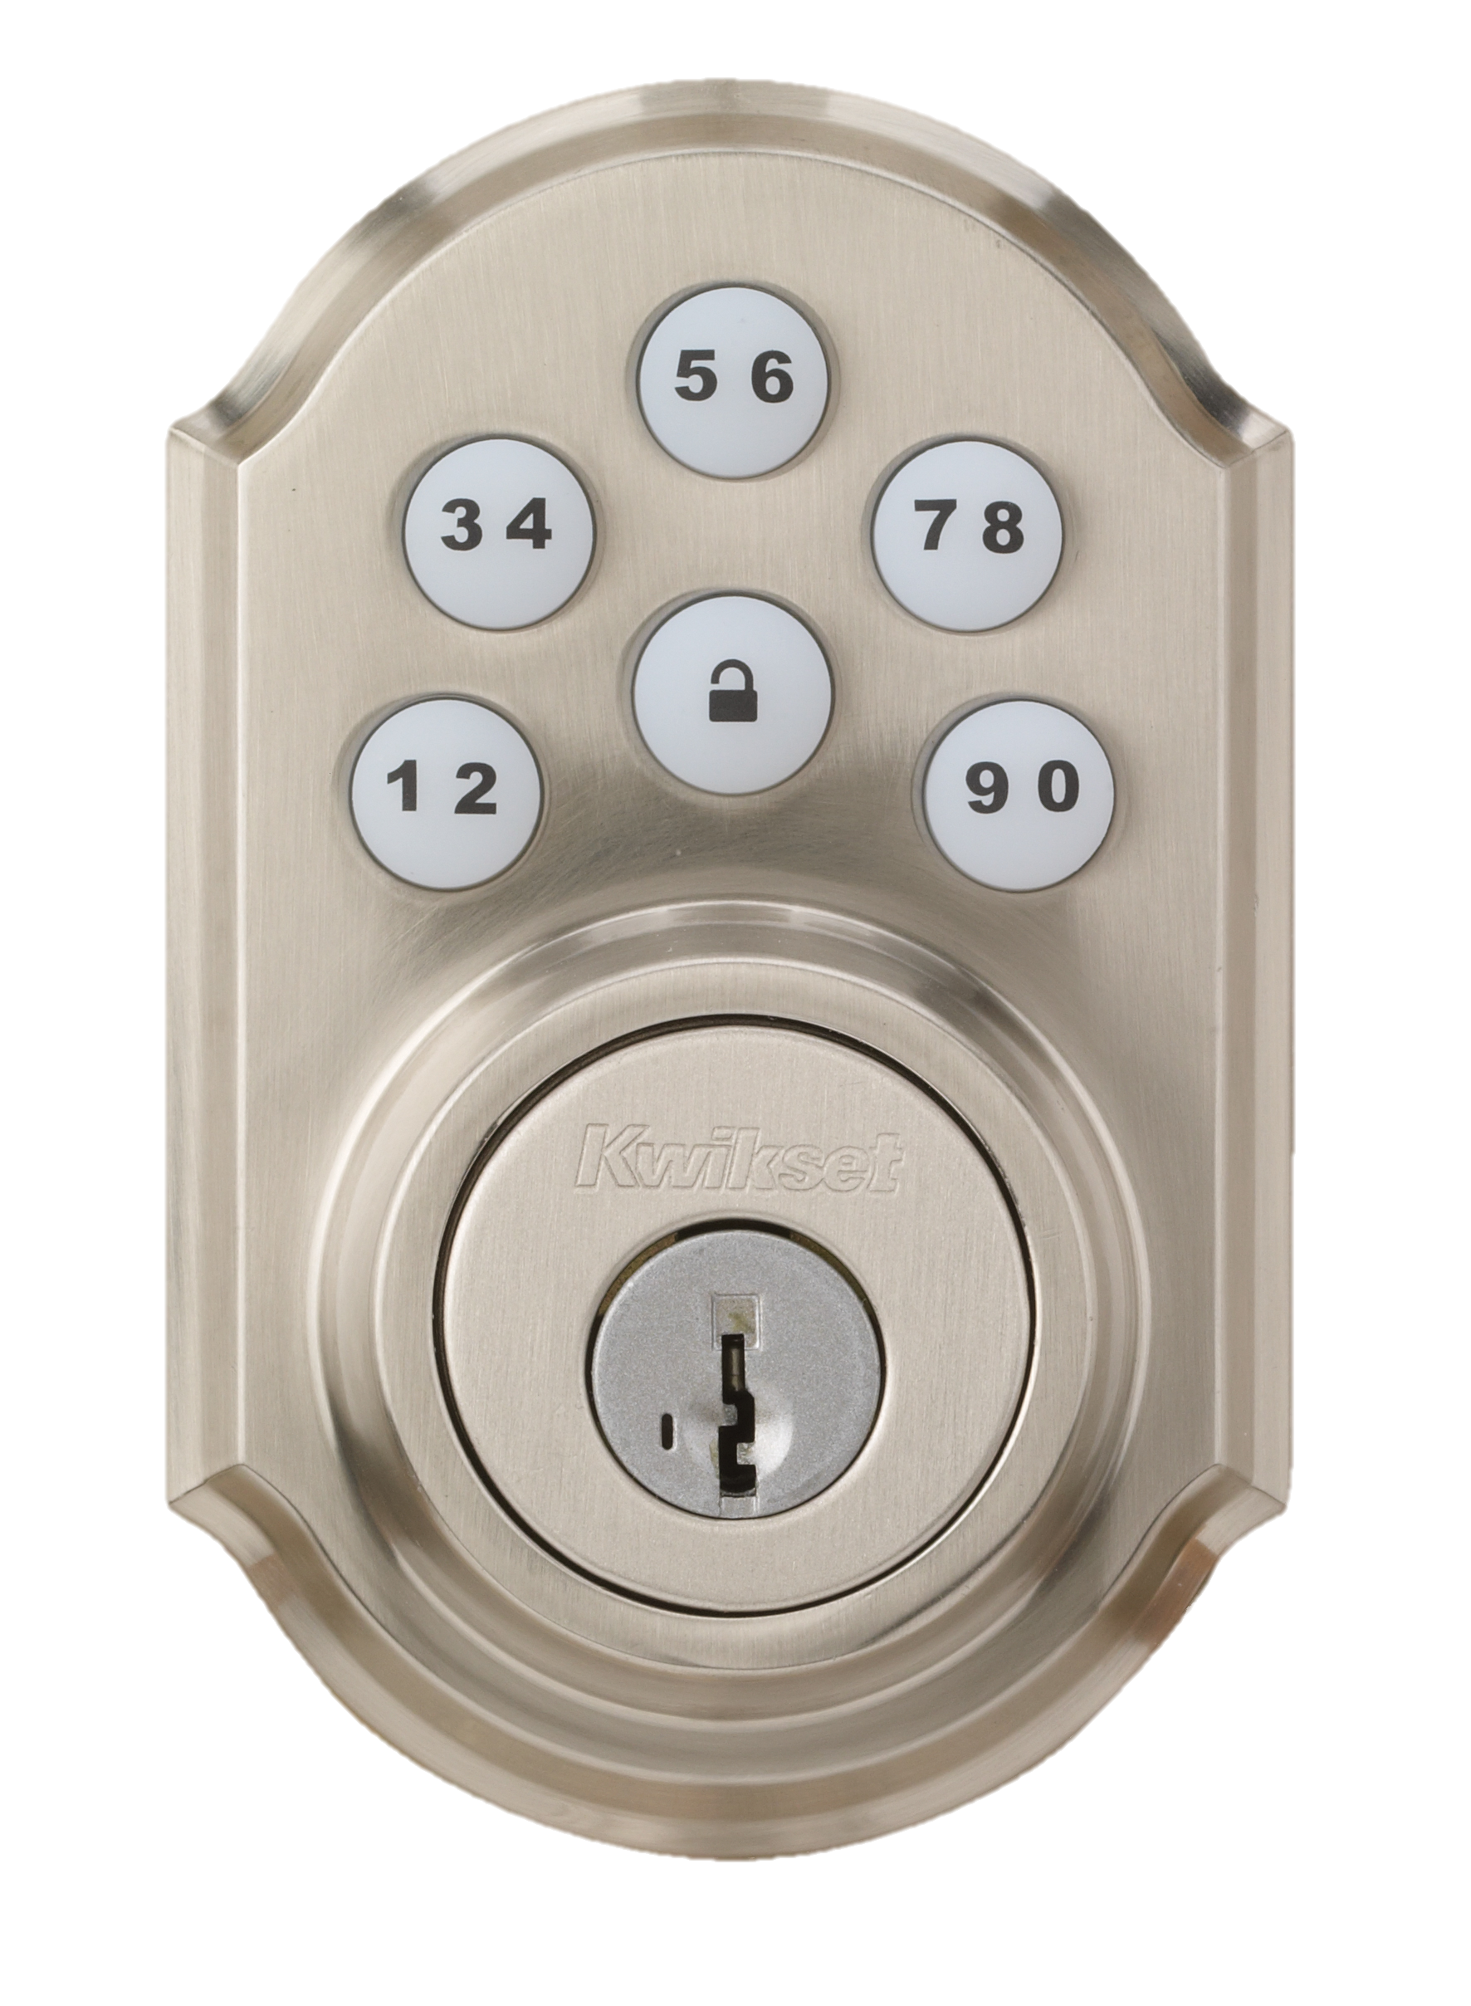
Fail Safe / Fail Secure
Lock example
  Fail safe: fail unlocked power to lock
  Fail secure: fail locked power to unlock

Slide 25
Mythbusters
Encryption ≠ cyber security
  Encryption is a cyber security tool used primarily for confidentiality
Hackers are not kids. Hackers are often:
  Insiders
  Governments
  Terrorists
  Organized Crime
Security by obscurity
  Hackers love obscure. They are that kind of people
  Hackers thrive on obscure. There is less attention on their actions if no one thinks there is a problem

