Slide 1

Cyber Security For Civil Engineering
Lecture 1
Thiago Alves
Ph.D. Student at the University of Alabama in Huntsville

Slide 2
Who am I?
Ph.D. Student at the University of Alabama in Huntsville
SCADA Cyber Security Researcher at the Center for Cybersecurity Research and Education (CCRE)
Creator of the OpenPLC Project: www.openplcproject.com – The first fully open source Programmable Logic Controller

Slide 3
What is Cyber Security?
Cyber security is the body of technologies, processes and practices designed to protect computers, programs and data from attack, damage or unauthorized access.
Notes:
When a computer is embedded in a system, we usually call it CONTROLLER

Slide 4
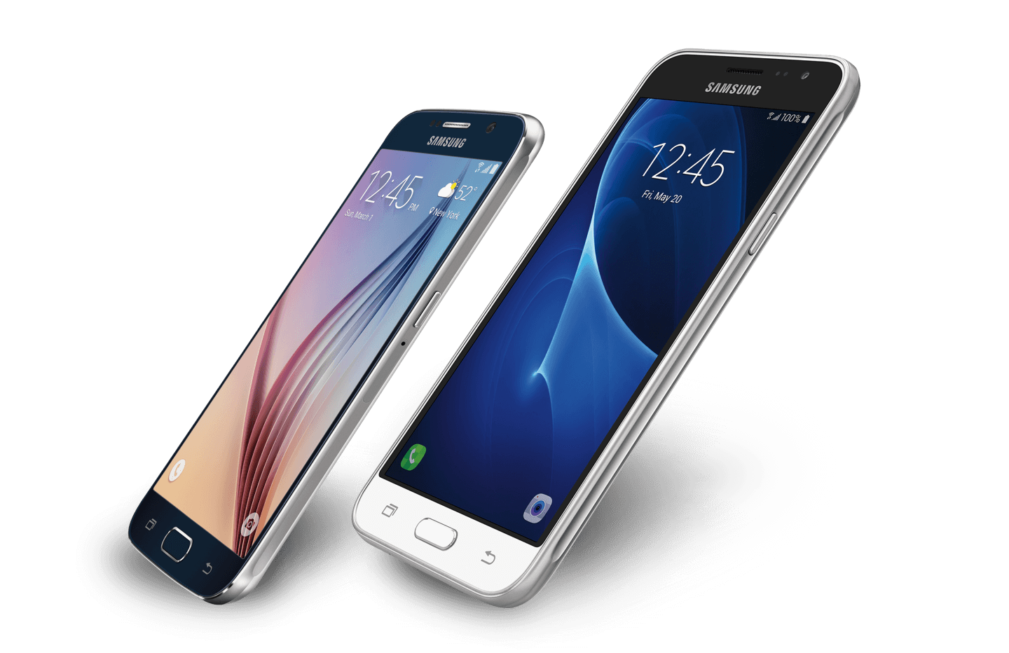
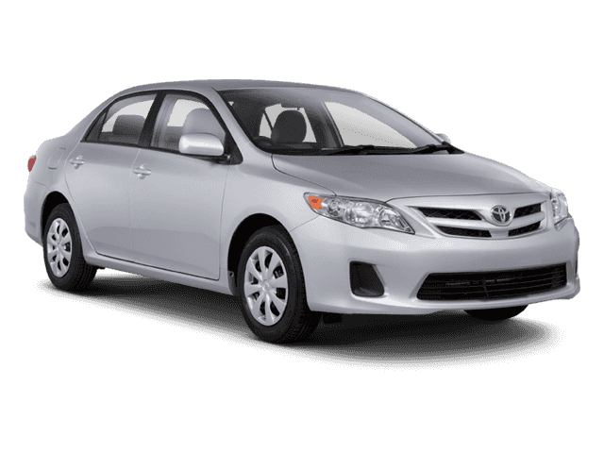
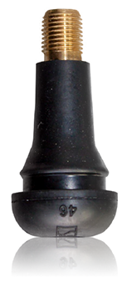
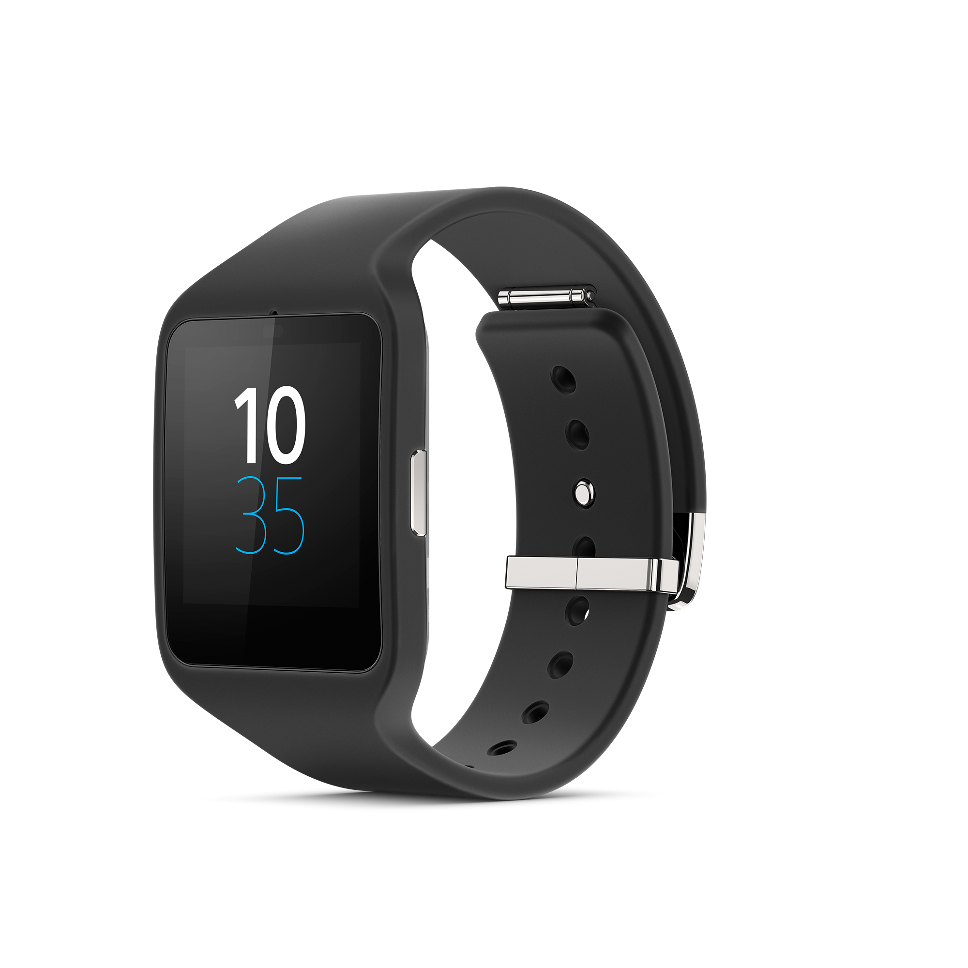

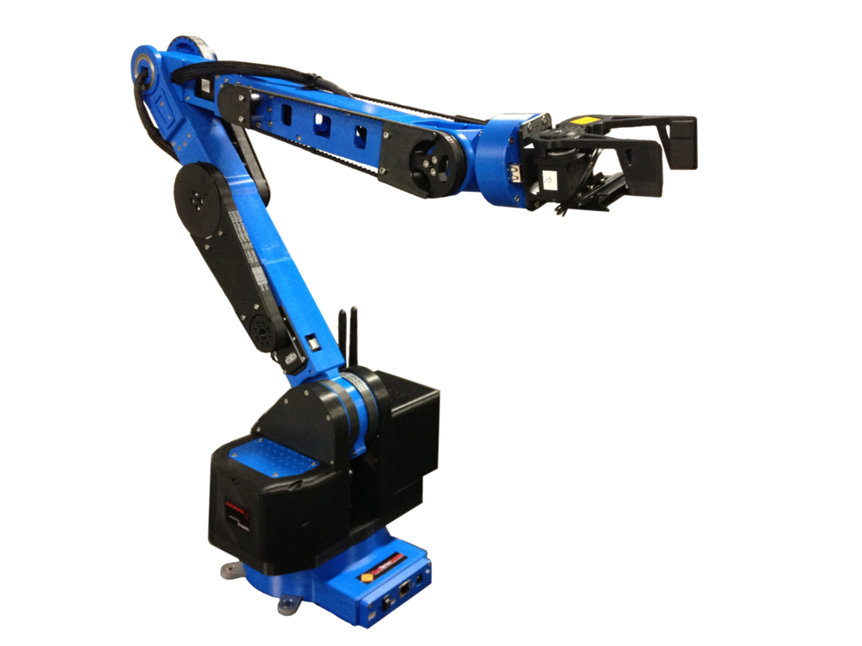
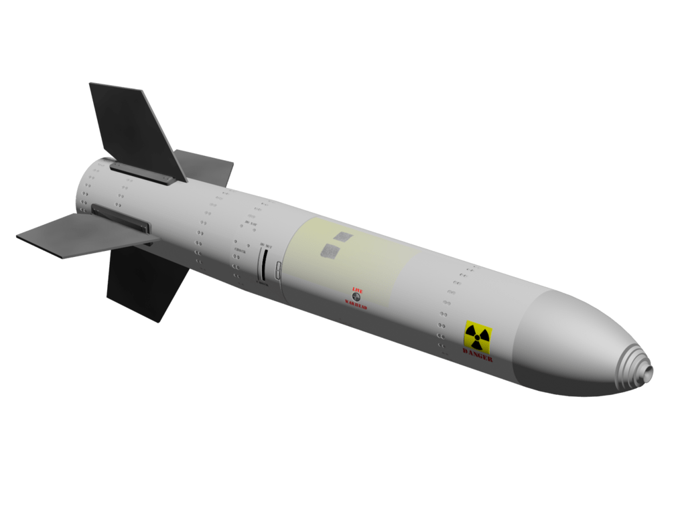
What is a Computer?
Notes:
When a computer is embedded in a system, we usually call it CONTROLLER

Slide 5
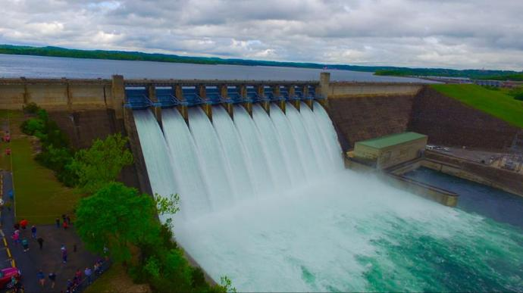
Dam Control and Monitoring
Notes:
Are there computers here?
Hydraulic drives, gate controls, water level monitoring, etc

Slide 6
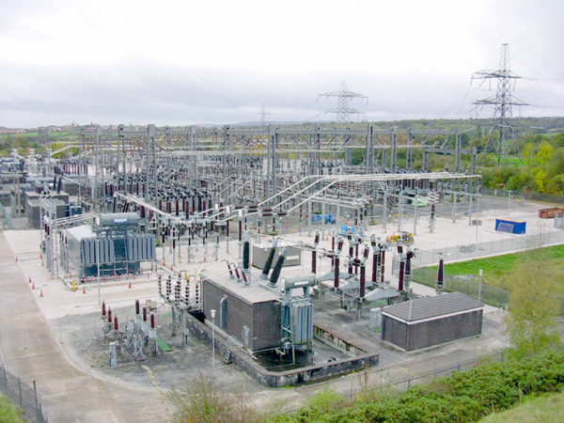
Substation
Notes:
Are there computers here?
Situational Awareness
Control -> Open/Close breakers

Slide 7
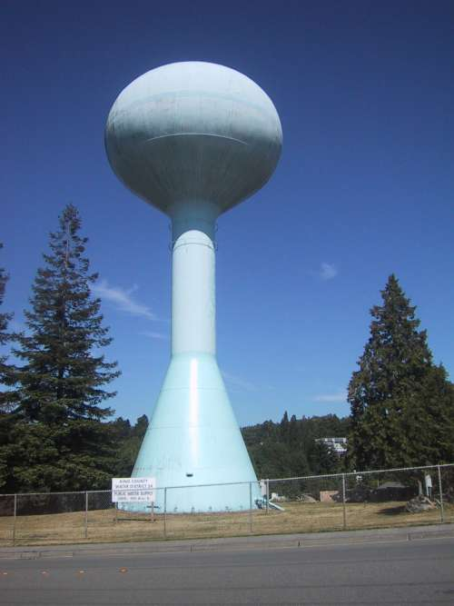
Water Distribution
Notes:
Are there computers here?
Hydraulic drives, gate controls, water level monitoring, etc

Slide 8
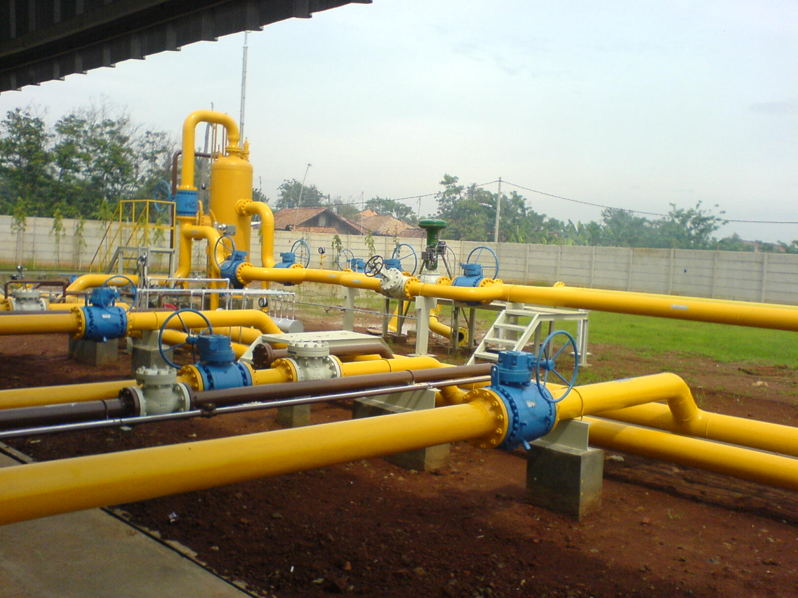
Oil/Gas Distribution
Notes:
Are there computers here?
Monitor Pressure
Route Product
Billing

Slide 9
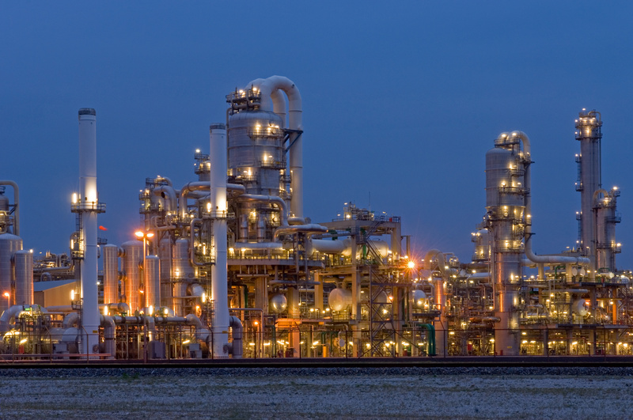
Petrochemical
Notes:
Are there computers here?
Safety
Storage
Distillation Tower

Slide 10
The set of computers, networked data communications and graphical user interfaces that monitors and control industrial processes is called SCADA

Slide 11
What Is SCADA?
Supervisory Control And Data Acquisition
Notes:
When controllers are applied to processes like shown before, the system is usually called SCADA

Slide 12
What Is SCADA?
Supervisory Control And Data Acquisition
Huh?!

Slide 13
What Is SCADA?
Supervisory Control And Data Acquisition
Supervisory | Control | Data Acquisition
Supervisor synonyms Manager Overseer Administrator | Change current state of process Open close breakers, switches, valves, etc. | Situational Awareness Monitoring

Slide 14
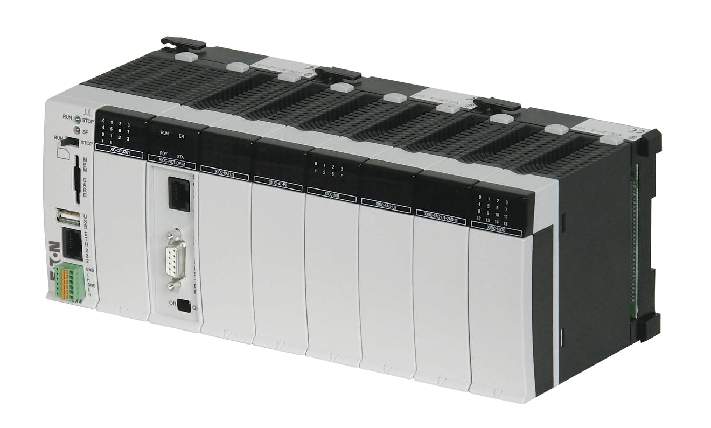
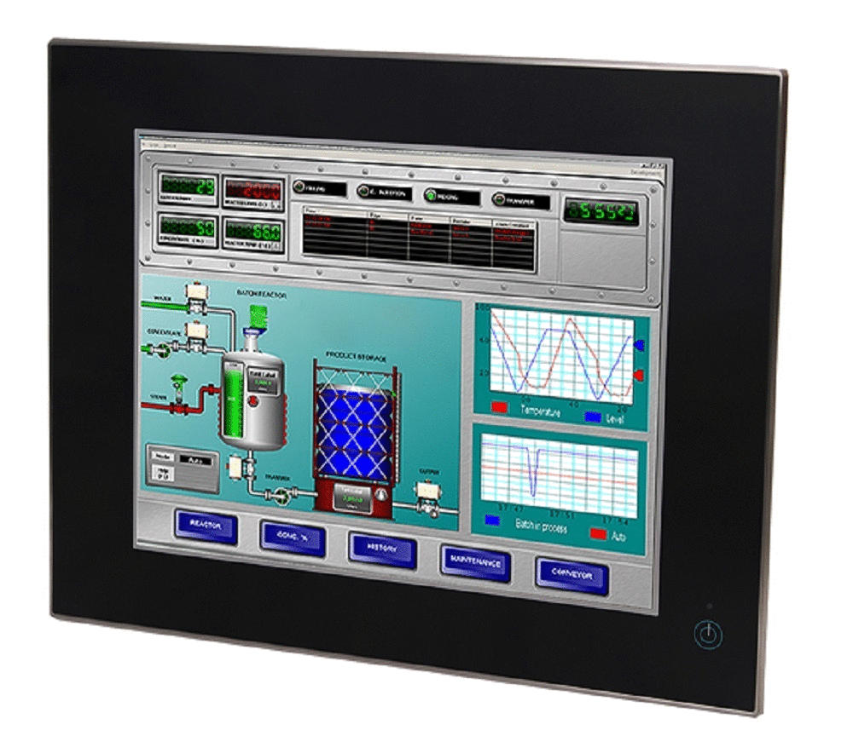
SCADA Architecture
Physical System
(sensors and actuators)
Wired or Wireless Connection
Programmable Logic Controller (PLC)
Enterprise Network / Internet
Human-Machine Interface

Slide 15
Physical System
Physical structure for the process
Embedded sensors that measure quantities such as pressure, temperature, flow, or density
Embedded actuators to control mechanisms such as solenoids, valves, or gates

Slide 16
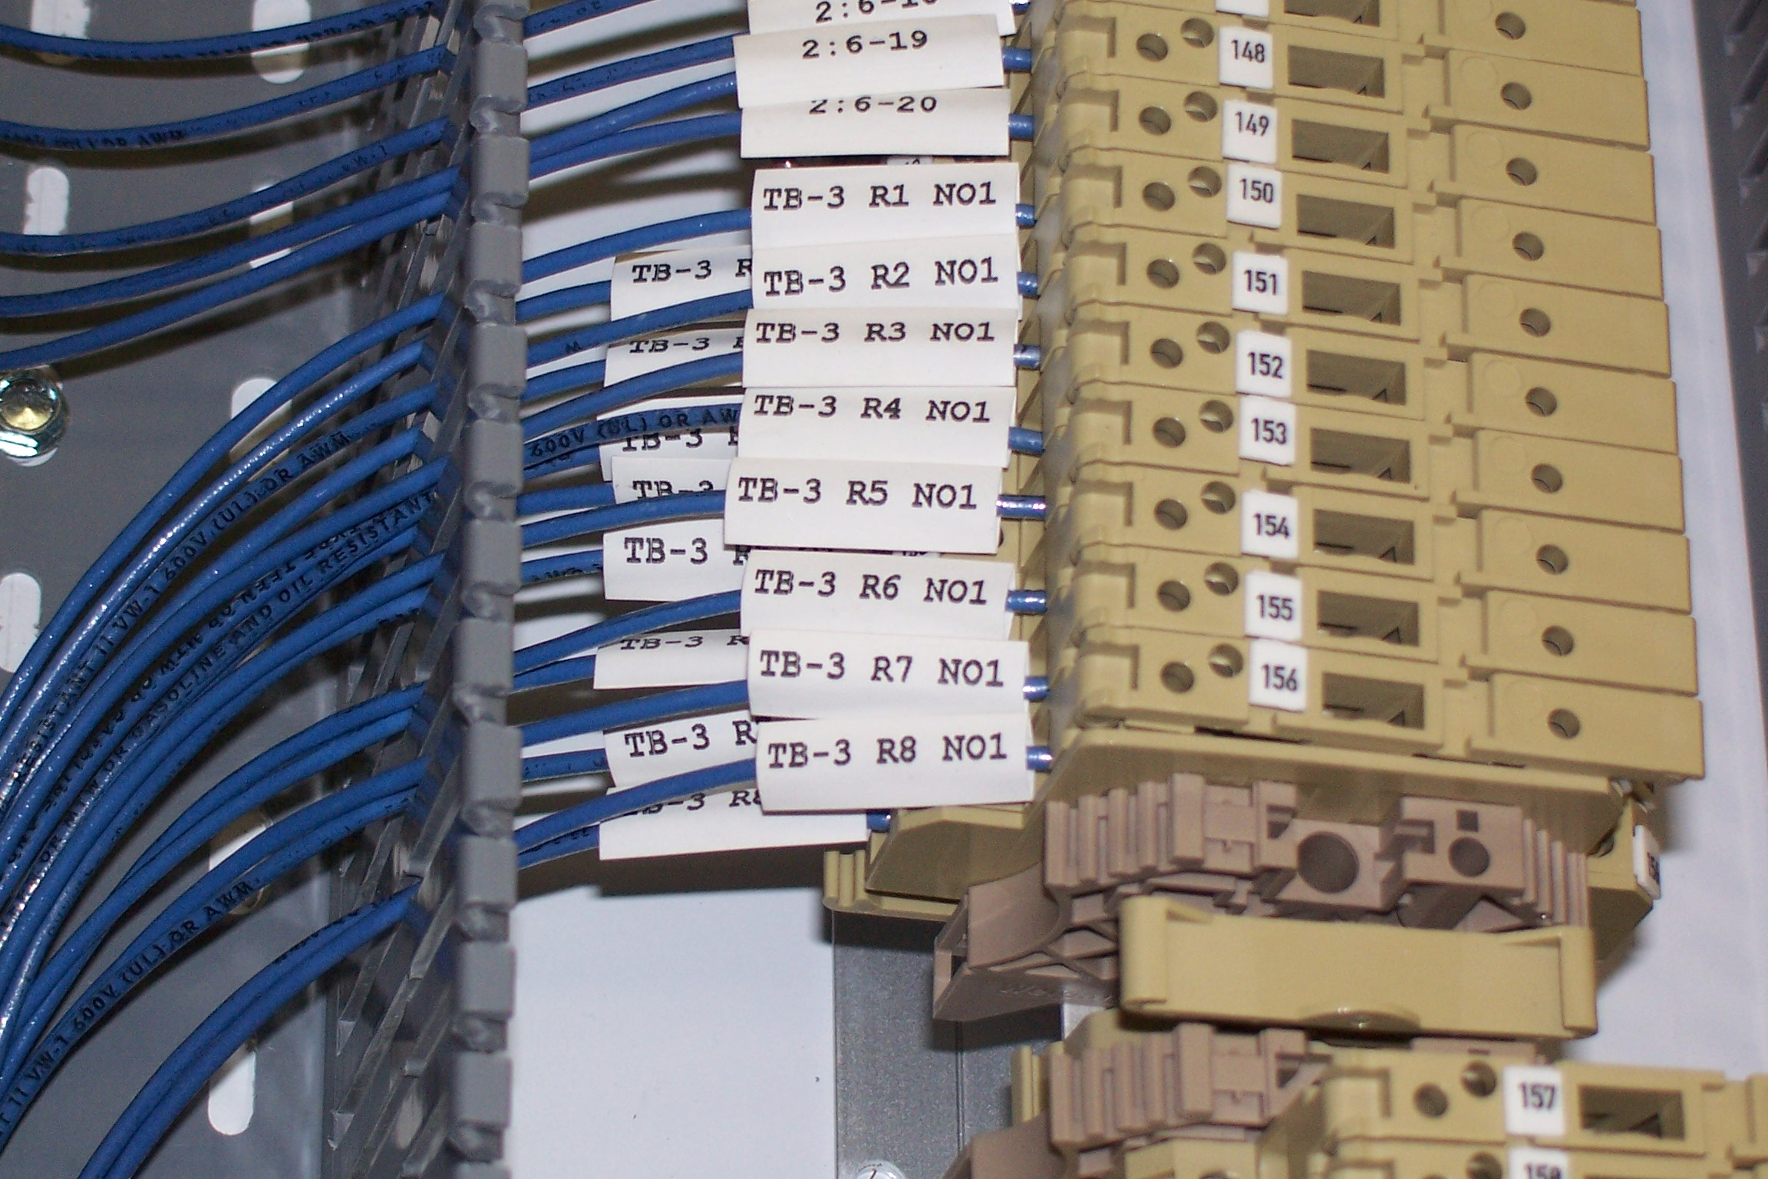
Wired (or wireless) Connection
Sends sensor signals to the controller
Sends controller commands to the actuators
Electrical communication between the controller and its physical interfaces

Slide 17
Programmable Logic Controller
Digital Computer used on Automation
Input modules read data from sensors
User program decides what to do based on the input data
Output modules control actuators on the physical system

Slide 18
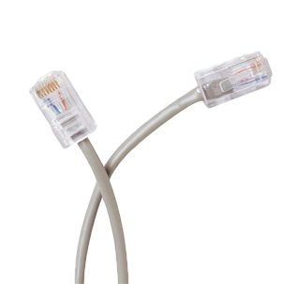
Enterprise Network / Internet
Allows data exchange between the Programmable Logic Controllers and other computers
Enables supervisory software to query information from the plant
Communication follows a set of rules called Protocol
Output modules control actuators on the physical system

Slide 19
Human Machine Interface
Graphical screens that consists of buttons, alarms, reports and trends about the process
Manages the physical process data
Provides a mechanism for user interaction and control

Slide 20
Live Demo
Water Temperature Control

Slide 21
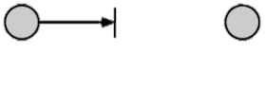
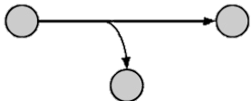
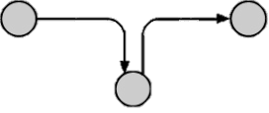
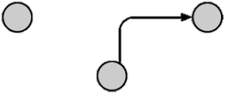
Types of Harm
Interruption
Interception
Modification
Injection

Slide 22
C-I-A Triad
Confidentiality
Integrity
Availability

Slide 23
Confidentiality
Confidentiality is roughly equivalent to privacy. Measures undertaken to ensure confidentiality are designed to prevent sensitive information from reaching the wrong people, while making sure that the right people can in fact get it.
Notes:
Discuss examples where confidentiality would and would not be important.
Not important: Water level on a water storage tank.
Important: Password to the gate controls on a penitentiary

Slide 24
Integrity
Integrity involves maintaining the consistency, accuracy, and trustworthiness of data over its entire life cycle. Data must not be changed in transit, and steps must be taken to ensure that data cannot be altered by unauthorized people.
Notes:
Discuss examples where integrity would and would not be important.
Not important: Bathroom lights control (questionable)
Important: Flood gate controls on a dam

Slide 25
Availability
Availability means that the computing systems used to store and process the data, the security controls used to protect it, and the communication channels used to access it must be functioning correctly. High availability systems aim to remain available at all times, preventing service disruptions due to power outages, hardware failures, and system upgrades.
Notes:
Discuss examples where availability would and would not be important.
Not important: None
Important: All

